Slide 1
The Cyber Security Challenges
Michael Trofi, CISSP, CISM, CGEIT
VCISO
Trofi Security
mtrofi @trofisecurity.com

Slide 2
Topics
Evolving Cyber Threat
Methodology Used
Summary

Slide 3
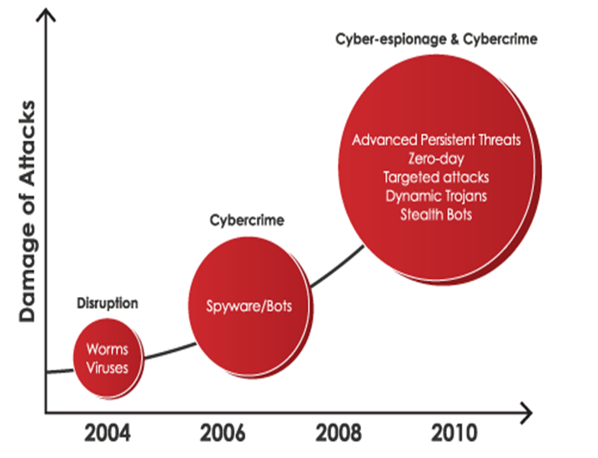
Rapidly Evolving Cyber Threat

Slide 4
Threats Are A Growth Industry
93% Increase in Web Attacks in 2010 over the volume observed in 2009
6,253 New Vulnerabilities
Symantec recorded more vulnerabilities in 2010 than in any previous year since starting this report.
42% More Mobile attacks
Symantec recorded over 3 billion malware attacks in 2010
286M+ types of Malware identified in 2010
260,000 average number identities exposed per breach
Rustock, the largest botnet observed in 2010, had well over 1 million bots under its control
Underground economy advertisement in 2010 promoting 10,000 bots for $15.

Slide 5
Motivational Model
Using a virtual world for real world affects:
Money
Information & Intellectual Property theft
Terrorism
Bragging rights (ego)
Low Risk + High Payoff = High Probability of Occurrence

Slide 6
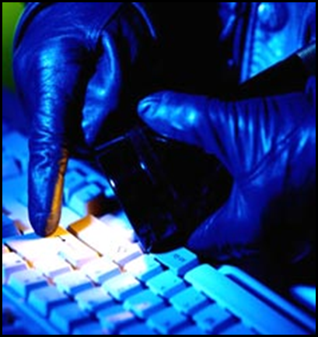
Cyber Crime
Malicious criminal actors
Organized crime
China, Iran, Russia, Ukraine, and Romania most sophisticated financial cybercriminals
Tools
Highly capable cyber tools
Financially motivated to sell tools and services
Malware used to steal banking credentials: SpyEye, Zeus, and Coreflood
Social networking/social engineering sites
Provide ideal environment for stealing user bank account access credentials

Slide 7
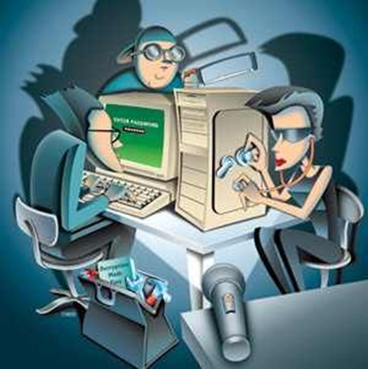
Targeting Techniques
Social engineering
Spear phishing
Spoofing e-mail accounts
Malware / Spyware (browsing)
USB thumb drives
Supply-chain exploitation
Mobile devices
Leveraging trusted insiders

Slide 8
Recent Trends
June 2010 Citigroup hack
Hackers accessed 260K accounts and stole $2.7M from credit card holders – one of the largest direct attacks on a bank
Small- to medium-sized businesses perceived to lack strong IT security
Hackers increasingly taking advantage of lack of sophisticated security

Slide 9
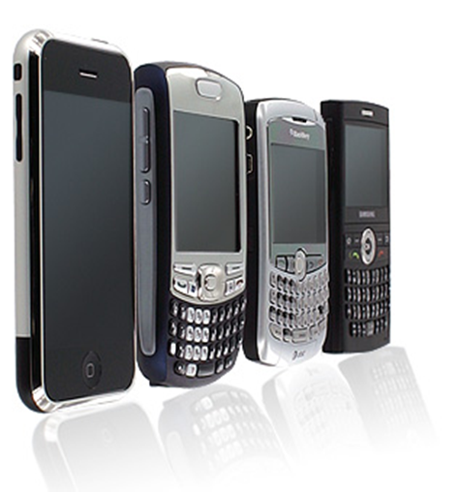
Recent Trends
Smartphones and fraud
Hackers accessing smart phones to gather PII and log-on credentials
As mobile banking popularity increases, hackers may increasingly seek to exploit mobile applications for financial gain
Major encryption providers targeted as a means to gain trusted access to government/private sector networks

Slide 10
Threats to worry about
Human Threats
Blackmail | Extorting money, system information, or something else of value from an employee, by the threat of exposing discreditable information.
Bribery | Offering money or something of value, in order to gain system access.
Eavesdropping | Connecting to, or tapping, the voice or data transmissions by an unauthorized individual to gain access to the message content for the purpose of reviewing it.
Fraud | An act, statement, or omission deliberately practiced to gain unauthorized system access.
Hacking | Gaining unauthorized system access.
Impersonation | Misinterpretation of human or cyber identity.
Improper Handling of Sensitive Information | The failure of authorized individuals to handle sensitive information in accordance with applicable policies and procedures, possibly compromising the information.
Interception | Capturing unauthorized data for malicious intent.
Intimidation of Personnel | To coerce or inhibit employees, usually by threats, to gain unauthorized access to internal networks.
Malicious Mobile Code | Distribution of viruses, logic bombs, Trojan horses, etc., with the intent to corrupt or obtain system data.
Spyware/Adware/malware | Malware is software designed to attack and damage, disable, or disrupt computers, computer systems, or networks. Hackers often take advantage of website security flaws, also known as vulnerabilities, to inject malware into existing software and systems with consequences that can range from the relatively benign—like annoying pop-up windows in a web browser—to the severe, including identity theft and financial ruin.
Instant Messaging | Can lead to employees leaking out company data through casual text chatting off these Internet Messaging platforms. These Internet Messengers are also used for impersonation attacks, Identity thefts and social engineering attacks.
Web Based Attacks | Web based attacks are considered by security experts to be the greatest and oftentimes the least understood of all risks related to confidentiality, availability, and integrity. The purpose of a web based attack is significantly different than other attacks; in most traditional penetration testing exercises a network or host is the target of attack. Web based attacks focus on an application itself and functions on layer 7 of the OSI protocol stack.

Slide 11
Threats to Worry About (Cont.)
Botnets | A botnet is an army of compromised machines, also known as "zombies," that are under the command and control of a single "botmaster." The rise of consumer broadband has greatly increased the power of botnets to launch crippling denial of service (DoS) attacks on servers, infect millions of computers with spyware and other malicious code, steal identity data, send out vast quantities of spam, and engage in click fraud, blackmail, and extortion. Botnets are the primary security threat on the Internet today. It is easy to commission botnet attack services and hackers are quicker than ever to exploit new vulnerabilities. Tens of thousands of machines are typically part of a single botnet. Botnets are hard to detect because they are highly dynamic in nature, adapting their behavior to evade the most common security defenses.
DOS | One of the most popular exploits used by politically-motivated cyber attackers today is the distributed denial of service (DDoS) attack, in which Web servers or other Internet-connected systems are overwhelmed by large amounts of inbound traffic. Such attacks can interrupt business operations and make an organization unavailable to its customers – but they also can be difficult to anticipate and even more difficult to stop.
Masquerading (Spoofing) | A technique used to spoof remote devices by having devices, such as bridges and routers, answer for remote devices.
Negligence or Human Error | Failure to act carefully and responsibly, resulting in unintended destruction, degradation, or confidentiality of data.
Password Guessing | Attempting to obtain system passwords by unlawful methods (e.g., dictionary attack, password cracker tools, and intercepting network packets).
Resource Misuse and Abuse | The unauthorized use of any asset for a purpose other than originally intended.
Sabotage/Vandalism | The deliberate destruction or degradation of any system and/or component.
Phishing, Social Engineering | A method of obtaining information to be used for compromising a system (e.g., a password) from an individual rather than by breaking into the system. Social engineering can be used over an extended period of time to maintain a continuing stream of information and help from unsuspecting users.
System Tampering | Interfering with the system in a harmful manner resulting in degradation or unavailability of system and/or resources.
Theft | Acquisition of data, hardware and/or software by unauthorized individuals.

Slide 12
Threats to Worry About (Cont.)
Unauthorized Disclosure of Information | Providing system related information to unauthorized user(s).
Unauthorized External Access | The ability and opportunity of an external source to obtain information, or physical access to facilities, without proper authorization or clearance.
Unauthorized Internal Access / Malicious Insiders | The ability and opportunity of an internal source to obtain information, or physical access to facilities, without proper authorization or clearance.

Slide 13
Changing Threat Landscape Summarized

Slide 14
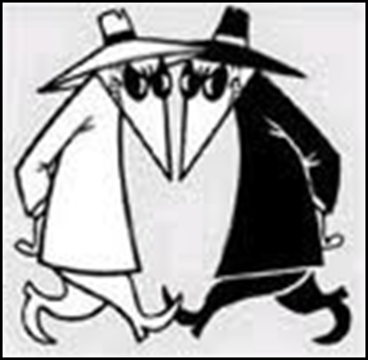
So What?
Computer network exploitation by threat actors enables:
Massive financial losses
Degradation/disruption of services
Extortion
Intellectual property theft
Counterfeiting
Theft of proprietary data
Identity theft (personally identifiable information)
Access to credit
Loss of money, reputation, and credibility

Slide 15
Holistic Approach Needed
The threat takes a holistic approach to you
So you better do the same
Do not expect warning for cyber any better than you get for the flu.
It’s out there, it’s coming
Technology will fail to stop attacks
It is not just remote hacking
People will make mistakes and perhaps betray you
Products will betray you
Better have business process that ANTICIPATES this
And then have a multi-faceted, holistic approach

Slide 16
Threat is Diverse
Recognize that sophistication is not just technology
Tradecraft to operate clandestinely and gain access
Resources and operational infrastructure
Organization to execute
Knowledge of your business and infrastructure
And not just remote attacks
Remote hacking most common and largest scale
Manipulate people’s curiosity, greed, and fear (call the IRS)
Insiders still appear to do most damage
Remote recruitment of people (mules)
Physical access enables greater access (wireless, key loggers, weaken crypto)
Loss and theft of laptops, portable media, and servers
Supply chain, mostly as counterfeit and fraud

Slide 17
Insiders To Worry About
People with administrative privilege access to networks
These guys should be audited
They should not have access to critical information
Crypto maintenance should be separate
People with physical access
Maintenance and cleaning
Thumb drives (one time theft vs. air gap jumping)
People who understand what matters to you
Know where to look or what to break

Slide 18
Planning for Cyber Health
If it is easy and convenient for you, so it will also be for the evil people.
If connected to Internet and have anything of value, you will be plundered systematically for information, access, privilege, money, or bandwidth.
If doing anything that matters on the Internet, somebody at some point will interfere with or exploit your activity, perhaps without even compromising your machines, and you can’t stop it.
If you are doing anything on the Internet that is vital and critical to your livelihood, public safety, or national security, then STOP IT.

Slide 19
Planning for Cyber Health (2)
Mobile Machines and data will be lost or stolen – plan on it
Once owned by sophisticated adversaries, will never be sure of purging them:
Need to do complete rebuild of ENTIRE system (BIOS level, all network elements, every endpoint)
AND re-issue all system credentials
If you still insist on using the Internet, have a plan:
How to backup, restore, and rebuild quickly, repeatedly
Know your service providers (ISPs and proxies).
Encrypt and authenticate what matters
Like public health: infrastructure, response, and hygiene

Slide 21
Risks
Security Risks - Security breaches to your corporate network can result in significant financial and reputational losses as well as compromise control over network assets. Threats include Viruses, Trojans and Spyware attacks.
Productivity Risks - Business productivity is at risk from unfiltered and unmonitored use of the Internet including use of IM, VoIP and chat room facilities which can severely limit time at work and waste precious IT resources through increased troubleshooting, support and bandwidth congestion.
Legal Risks - Uncontrolled use of network resources can raise a variety of legal issues, including possible disclosure of proprietary information and exposure to unwanted and often offensive content, claims from transmission of viruses as well as claims for denial of service.
Confidentiality Risks - Refers to the impact of unauthorized access and distribution of information assets, such as client information, passwords and research data.
Compliance Risks - Refers to impact of failure to meet the increasingly complex and growing scope of government regulations relating to effective systems and processes for data control. Regulations include: PCI, Sarbanes-Oxley Act, Gramm-Leach Bliley Act, Basel II, HIPAA and SAE-16.

Slide 22
Severity (Impact)
High: | The loss of confidentiality could be expected to have a severe or catastrophic adverse effect on organizational operations, organizational assets, or individuals.
 | A severe or catastrophic adverse effect means that, for example, the loss of confidentiality might: (i) cause a severe degradation in or loss of mission capability to an extent and duration that the organization is not able to perform one or more of its primary functions; (ii) result in major damage to organizational assets; or (iii) result in major financial loss.
Medium: | The loss of confidentiality could be expected to have a serious adverse effect on organizational operations, organizational assets, or individuals.
 | A serious adverse effect means that, for example, the loss of confidentiality might: (i) cause a significant degradation in mission capability to an extent and duration that the organization is able to perform its primary functions, but the effectiveness of the functions is significantly reduced; (ii) result in significant damage to organizational assets; or (iii) result in significant financial loss.
Low: | The loss of confidentiality, integrity, or availability could be expected to have a limited adverse effect on organizational operations, organizational assets, or individuals.
 | A limited adverse effect means that, for example, the loss of confidentiality, integrity, or availability might: (i) cause a degradation in mission capability to an extent and duration that the organization is able to perform its primary functions, but the effectiveness of the functions is noticeable reduced; (ii) result in minor damage to organizational assets; or (iii) result in minor financial loss.

Slide 23
Likelihood
The Likelihood of each situation is subjective based upon the experience of the cross-functional management team. This is the probability that a given critical function may be impacted by a given threat within the associated control environment. The likelihood is estimated with a high, medium or low probability.

Slide 24
Threat Examination Criteria
Confidentiality of Data or Systems: Confidentiality covers the processes, policies, and controls employed to protect information of customers and the institution against unauthorized access or use;
Integrity of Data or Systems: System and data integrity relate to the processes, policies, and controls used to ensure information has not been altered in an unauthorized manner and that systems are free from unauthorized manipulation that will compromise accuracy, completeness, and reliability;
Availability: The ongoing availability of systems addresses the processes, policies, and controls used to ensure authorized users have prompt access to information. This objective protects against intentional or accidental attempts to deny legitimate users access to information and/or systems.

Slide 25
Threat vs. Risk Matrix for Confidentiality Exposure
 | Natural | Environmental | Blackmail | Bribery | Eavesdropping | Fraud | Hacking | Impersonating | Improper Sensitive Information Handling | Interception | intimidation of Personnel | Malicious Mobile Code | Spyware/ Adware/ Malware
Security Risks | L | L | M | M | H | M | H | M | H | H | M | H | H
Productivity Risks | H | H | L | L | L | L | L | L | L | L | L | H | H
Legal Risks | M | M | M | M | M | M | M | M | H | M | M | M | H
Confidentiality Risks | L | L | M | M | H | M | H | M | H | H | M | L | H
Compliance Risks | L | L | L | L | H | L | H | M | H | H | M | L | L
 | Instant Messaging | Web Content | BotNets | DOS | Spoofing | Human Error | Password Guessing | Resource Misuse | Sabotage/ vandalism | Phishing/ Social Engineering | System Tampering | Theft | Unauthorized Disclosure of Information | Unauthorized External Access | Unauthorized Internal Access
Security Risks | H | M | H | L | M | H | M | L | L | M | L | L | M | L | L
Productivity Risks | H | H | H | H | M | H | L | H | H | L | L | L | L | L | L
Legal Risks | M | H | M | H | L | H | L | L | M | M | L | M | M | L | L
Confidentiality Risks | H | H | H | L | H | H | L | L | M | M | M | M | H | L | L
Compliance Risks | H | L | H | M | L | H | M | L | M | M | L | M | H | L | L

Slide 26
Questions?

